Slide 1








1 of 13
Welcome to Planet Youth Timiskaming!
VOLUNTEER ORIENTATION
Youth Hub Volunteer Training 2025

Slide 2

what is planet youth?
Planet Youth Timiskaming is a program that helps prevent youth substance use and supports their overall well-being.
It follows a successful approach from Iceland that focuses on building strong community connections, creating safe spaces, and giving young people positive opportunities.
Northeastern Public Health is leading this initiative in Timiskaming, working with schools, families, and community groups to make a lasting impact.
Together, we can ensure all youth have the support and resources they need to grow and thrive.

Slide 3



3 of 13
what is planet youth?
MISSION:
Prevent youth substance use and promote ​holistic well-being through evidence-based initiatives.​
OBJECTIVES:
Strengthen community ties.​
Foster safe and inclusive spaces for youth.​
Encourage positive youth engagement and ​development.​
WHY IT MATTERS?
According to 2023 PYT survey results, the rates of constructive use of free time like organized sports or other leisure activities among youth were poor and that directly related to the high rates of substance use among youth in Timiskaming.

Slide 4
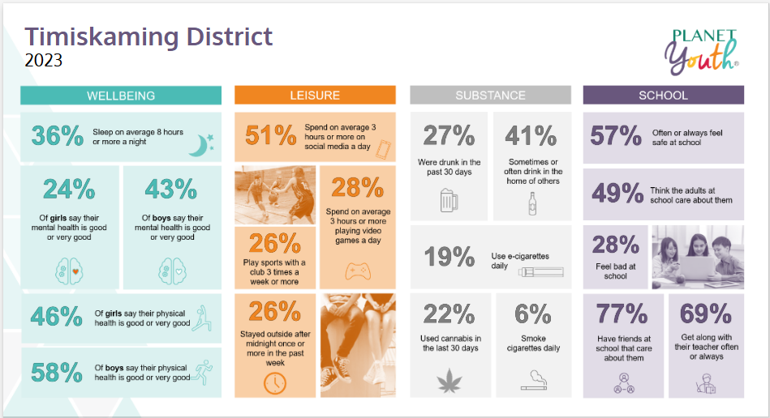

4 of 13

Slide 5


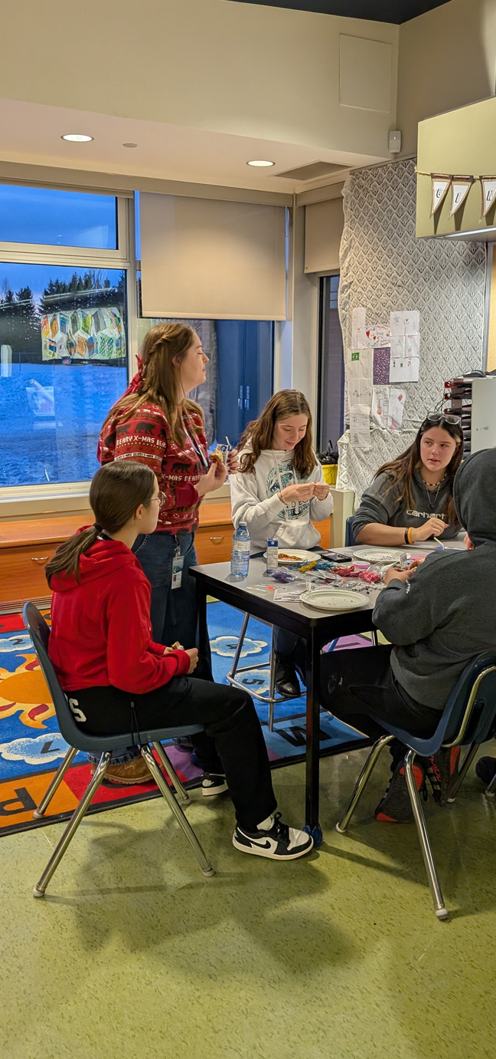
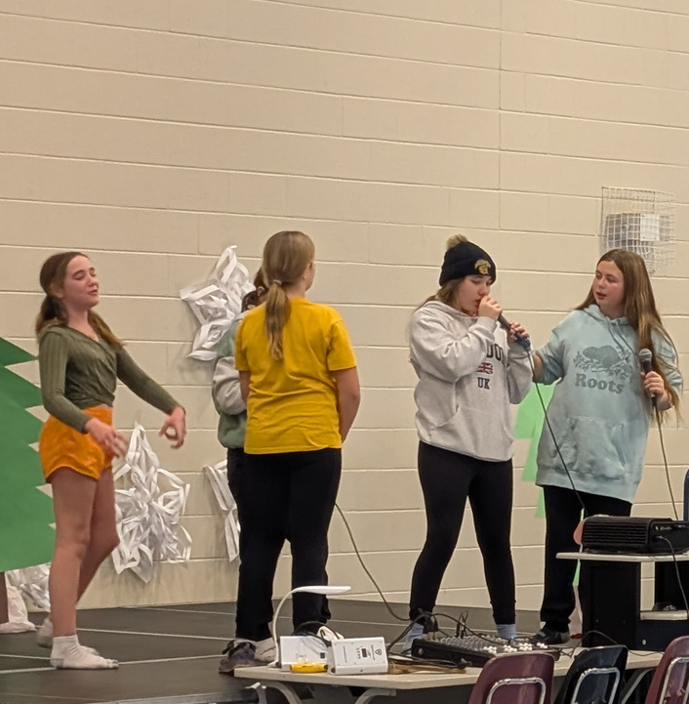
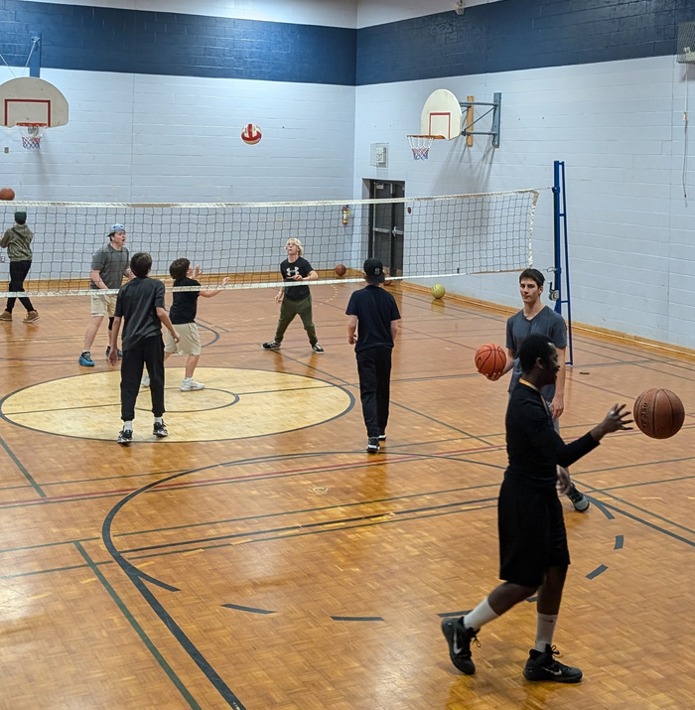
floating youth hubs
WHAT IS IT?
Floating Youth Hubs are drop in based, safe and welcoming spaces for youth aged 12-17 to hang out, meet new people, and take part in fun activities that are free.
Instead of having a fixed location, these hubs rotate between different schools and community spaces across Timiskaming, making it easier for more youth to join in.
FEATURES:
Open gyms, chill space, mental health support, free food and special activities
Check out Events Calendar on the website
for upcoming hubs!
5 of 13

Slide 6



THE GOAL?
Provide youth with opportunities to explore interests, build skills, and connect with peers.
6 of 13

Slide 7





Support youth engagement activities.
Foster a safe and inclusive environment.
roles & expectations
Act as a trusted adult ally for youth.
Collaborate with other volunteers and staff.
7 of 13

Slide 8




CORE PRINCIPLES:
Do’s & Don’ts
Respect, inclusion & empathy
Treat everyone with dignity and embrace diversity. Use inclusive language.
Support youth without overstepping personal or professional limits.
Report signs of harm and follow confidentiality guidelines.
Promote healthy, substance-free activities and contribute to a safe, inclusive environment.
DO’S
No discrimination, harassment, or bullying.
Do not use Alcohol or drugs at the hub or during events.
Do not share private information about youth or volunteers without necessity or consent.
DON’TS
8 of 13

Slide 9



GUIDE TO:
building strong connections with youth
9 of 13

Slide 10
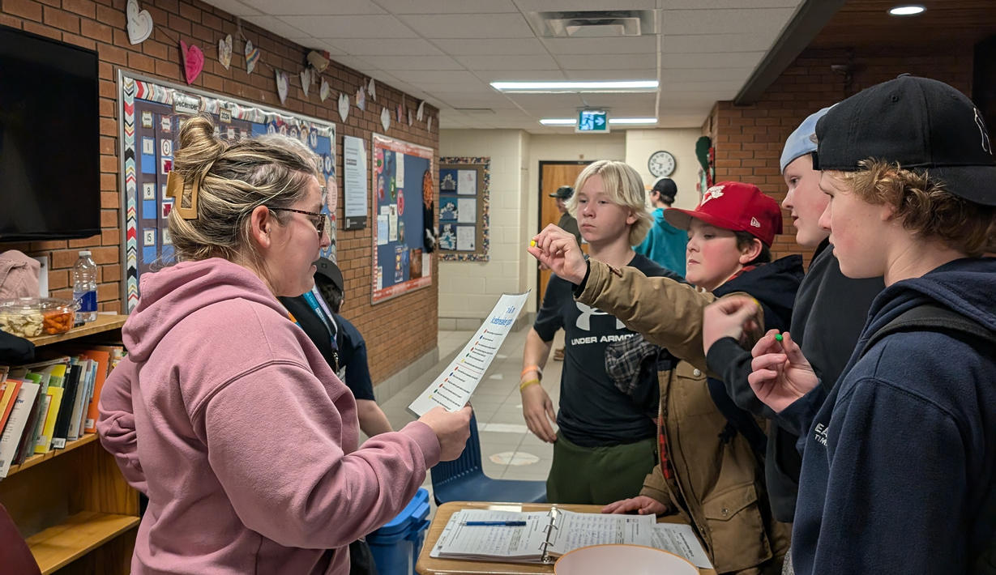
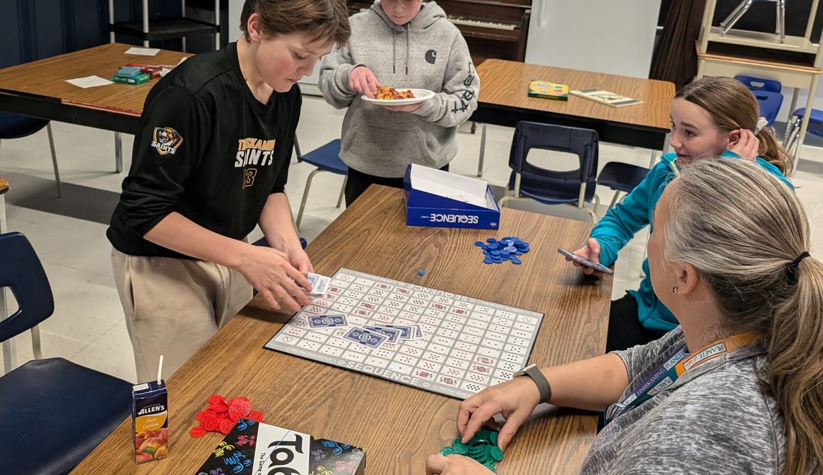

10 of 13
Be approachable and authentic.
Focus on strengths and celebrate achievements.
Use active listening and show empathy.
Encourage participation and create a welcoming atmosphere.
how to engage with youth?
Be strictly non judgemental!

Slide 11


11 of 13
resources
At Planet Youth Timiskaming, we are committed to empowering our volunteers with the resources they need to thrive. Here is a list of the key resources are included in your training package, ready to support you whenever you need them:
PYT Youth Hub-Volunteer Handbook
Student Peer Mentor -MENTAL HEALTH TRAINING (CMHA)
Be There Certificate: https://www.betherecertificate.org/
Training for My Organization or Community: https://livingworks.net/get-training/training-for-my-organization-or-community/
YWHO-How to be an Adult Ally Tip Sheet
YWHO- Youth Engagement Model
YWHO- Tips for Hosting Young People & Family

Slide 12




12 of 13
ready to make a difference?
NEXT STEPS:
Submit your signed forms and VSC (Vulnerable Sector Check).
Schedule your availability (Availability Form)
Complete the trainings that were listed.
Email archana.velu@neph.ca or erika.lamothe@neph.ca for more info or queries

Slide 13


https://timiskamingyouth.ca/
https://www.facebook.com/planetyouthtimiskaming

